Slide 1
STEPPING TOWARDS SUCCESS IN INFRASTRUCTURE INVESTMENT
STAIRS
Self- Assessment Tool for Appraising Investment Readiness in Sustainable Infrastructure

Slide 2
Bridging the Infrastructure Investment Gap
ASSESSING THE GAP
OVERVIEW OF STAIRS AND ITS FRAMEWORK
WALKTHROUGH WITH STAIRS
Copyright © DESA 2024. All Rights Reserved.

Slide 3
Accelerating Sustainable Infrastructure
Investments
BY 2029, INFRASTRUCTURE AUM IS PROJECTED TO REACH UP TO $2.29 TRILLION, NECESSITATING THE DEVELOPMENT OF A PIPELINE OF BANKABLE PROJECTS TO PREVENT THE ACCUMULATION OF DRY POWDER RESERVES

Slide 4
From Capital to Impact: Missing Link
Projects that are not properly prepared, with incomplete feasibility studies, inadequate risk assessments, and insufficient planning often fail to attract investment.
UNPREPARED PROJECT PROPOSALS
Investors are increasingly seeking projects that align with the United Nations Sustainable Development Goals (SDGs). Projects that do not demonstrate clear sustainability and social impact are less likely to secure funding.
LACK OF SDG ALIGNMENT
Poorly managed projects with weak leadership, inefficient operations, and insufficient monitoring and evaluation processes are often perceived as high-risk investments, making them less attractive to investors.
POOR MANAGEMENT QUALITY
PATHWAY TO INVESTMENT
By addressing these challenges through meticulous project preparation, aligning with the SDGs, and implementing robust management practices, projects can overcome the obstacles and become more attractive to potential investors.
Copyright © DESA 2024. All Rights Reserved.

Slide 5
STAIRS: Transforming Potential into Reality
COMPREHENSIVE SELF-ASSESSMENT TOOL
HELPS COUNTRIES EVALUATE INFRASTRUCTURE PROJECTS
IMPROVES INVESTMENT READINESS
STAIRS is a user-friendly tool designed to provide a thorough evaluation of a country's infrastructure project investment readiness.
The tool allows countries to assess the investment readiness of their infrastructure projects, identifying areas for improvement.
By using STAIRS, countries can identify and address gaps in their infrastructure project investment readiness, leading to more attractive and successful projects.
STAIRS IS A VALUABLE TOOL FOR COUNTRIES TO ASSESS AND ENHANCE THE INVESTMENT READINESS OF THEIR INFRASTRUCTURE PROJECTS, ULTIMATELY ATTRACTING MORE INVESTMENT AND DELIVERING BETTER OUTCOMES FOR THEIR CITIZENS.

Slide 6
Three-Pillar Framework
PROJECT READINESS
Assesses the overall preparedness and feasibility of the project, including the technical design, procurement plans, and the capacity of the implementing organization.
SDG ALIGNMENT & CONTRIBUTIONS Evaluates the project's alignment with the UN Sustainable Development Goals (SDGs) and its potential to contribute to the achievement of those goals, such as impact on poverty reduction, environmental sustainability, or access to education.
MANAGEMENT QUALITY AND INVESTMENT TRACK RECORD
Examines the quality of the project's management team, including their experience, expertise, and track record in implementing similar projects, as well as the financial and operational performance of previous investments.
ENSURING SUCCESS WITH A COMPREHENSIVE EVALUATION FRAMEWORK

Slide 7
Two-Stage Process
SECTION I: PROJECT INFORMATION
SECTION II: FUNDAMENTAL STRENGTHS AND DEFICIENCIES
COMPLETE SELF-ASSESSMENT STAGE
PRE-SCREENER STAGE
MINIMUM THRESHOLD
In this section, basic information about the project is collected, including the country of origin, region, project type and, a brief description of the project.
This stage identifies fundamental strengths and deficiencies in the project preparation process that can be addressed through guidance and education. The respondent is directed to a series of 10 main questions, some of which have a subset of 5 sub-questions. Answers are evaluated and scored using a 5-point scale.
If the project does not meet the minimum threshold of 2.84 (out of 5) in the preliminary assessment, the process stops at the pre-screener stage, and scoring, evaluation and guidance are provided only for this module. However, if the project meets the threshold, it advances to the Complete Self-Assessment stage.
In this stage, the respondent completes a comprehensive assessment exercise structured around three key pillars, consisting of 48 questions, including those presented earlier at the pre-screener stage. The respondent has the option to modify their previous responses, if needed.
Copyright © DESA 2024. All Rights Reserved.

Slide 8
STAGE I; PRESCREENER
SECTION I
SECTION II
Basic Information
Initial Fundamental Questions
ADDRESS FUNDAMENTAL ASPECTS
ACTIONABLE
SCORING ANALYSIS
RECOMMENDATIONS
METHODOLOGY
Score <2.84
RETURN BACK TO STAGE I
Score>=2.84
RESULTS & GAP ANALYSIS
Complete Questionnaire
STAGE II: COMPLETE SELF ASSESSMENT
Copyright © DESA 2024. All Rights Reserved.

Slide 9
Methodology
Weighted Scoring Matrix
Project Preparedness
60%
SDG Alignment & Contribution
25%
Investment Track Record & Management Team
15%
Project identification and approval
12%
ESG evaluation and documentation
5.00%
Management Quality
7.50%
Assessments
12%
Framework for SDG alignments
5.00%
Investment History
7.50%
Financial evaluation
12%
SDG alignments identified and established
5.00%
Technology Assessment
12%
SDGs contributions and metrics
5.00%
World Bank Preparedness Benchmark
12%
Framework for SDG tracking and analysis/verification
5.00%
*Data source: Weighted scoring matrix provided in the prompt.
Copyright © DESA 2024. All Rights Reserved.

Slide 10
Interpretation of Results
BANKABLE PROJECT
MAPPING
Score Range 1.1-2
DEVELOPMENT
PRESENTATION READY
Below average leevel of preparedness
Score Range 2.1-3
Score Range 4.1- 5
Average Level of Preparedness
Very High Level of Preparedness
IDEATION
REFINEMENT
PROJECT PROPOSAL
Score Rang 0-1
Score Range 3.1-4
Lowest level of preparedness
High Level of Preparedness
THE PROJECT PROPOSAL IS CATEGORIZED INTO VARIOUS STAGES BASED ON THE SCORES OBTAINED, CORRESPONDING TO ITS LEVEL OF PREPAREDNESS

Slide 11
STAIRS: A Roadmap to Sustainable Infrastructure Investment
GAP ANALYSIS
ACTIONABLE RECOMMENDATIONS
RESOURCE GUIDANCE
Analyze the weighted scores of each pillar and underlying factor to identify the gaps between actual and maximum possible scores. Use this quantitative analysis to prioritize the critical areas that end-users should address to improve the project's investment readiness.
The final report offers tailored recommendations to address the widest gaps, with a checklist of key preparatory aspects like feasibility, approvals, and risk analysis, enabling focus on the most impactful areas to enhance project readiness.
To bridge gaps and achieve objectives, provide country officials guidance on investment preparedness at project stages. Offer technical advice and literature to navigate concepts and procedures efficiently.
BY LEVERAGING STAIRS, UNDESA AIMS TO FACILITATE THE DEVELOPMENT AND IMPLEMENTATION OF HIGH-QUALITY, BANKABLE SUSTAINABLE INFRASTRUCTURE PROJECTS, CONTRIBUTING TO THE ACHIEVEMENT OF THE SUSTAINABLE DEVELOPMENT GOALS.

Slide 12
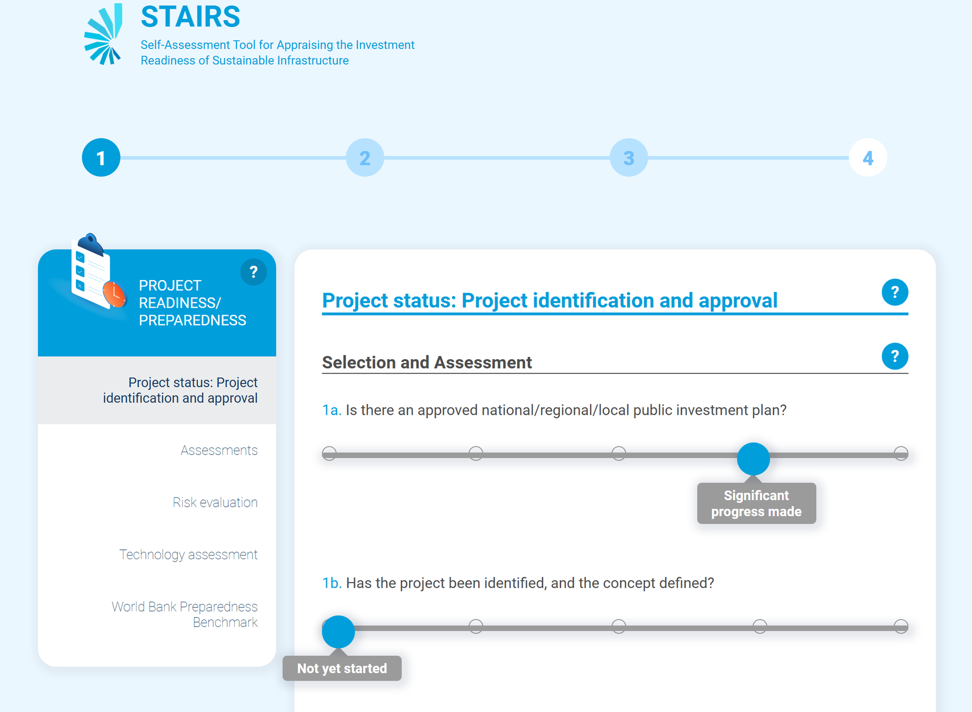
Walkthrough with STAIRS
Two- Stage Evaluation
STAGE 1- PRESCREENER
STAGE 1- SCORE
STAGE 2-COMPLETE SELF ASSESSMENT
Copyright © DESA 2024. All Rights Reserved.

Slide 13
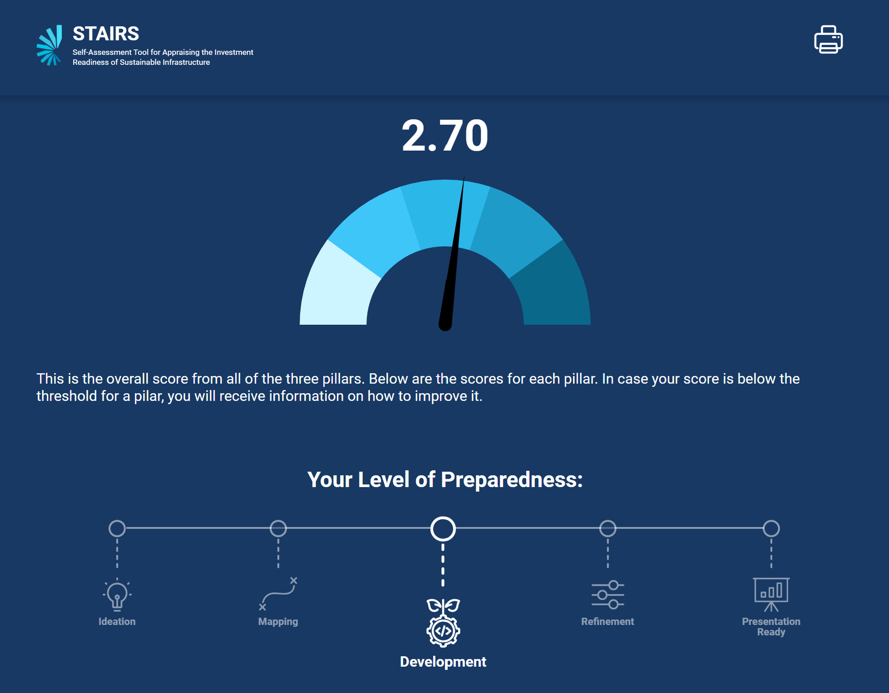
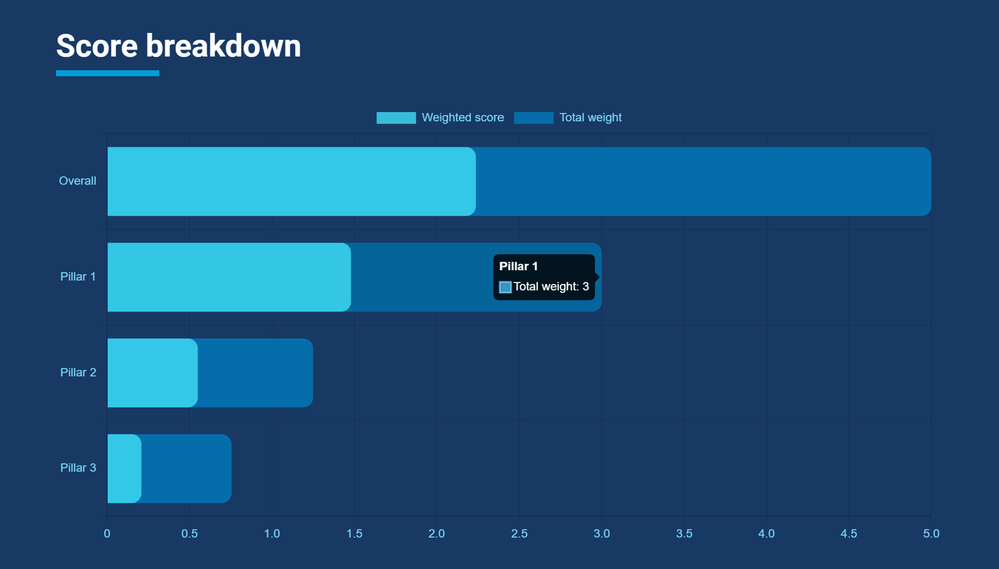
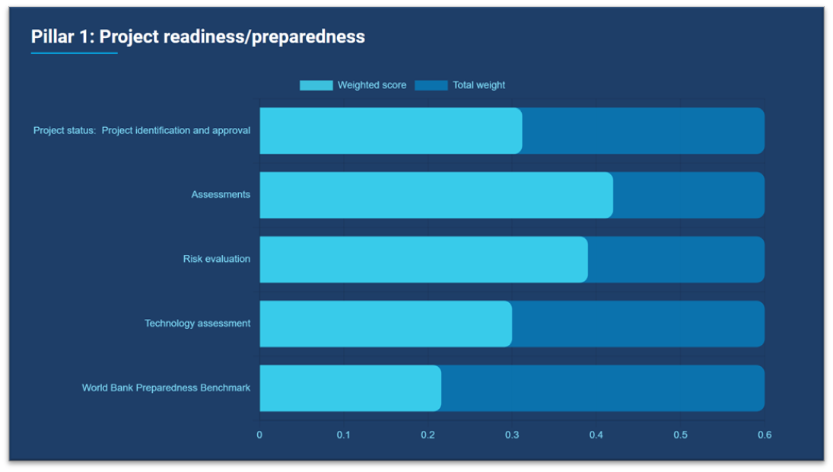
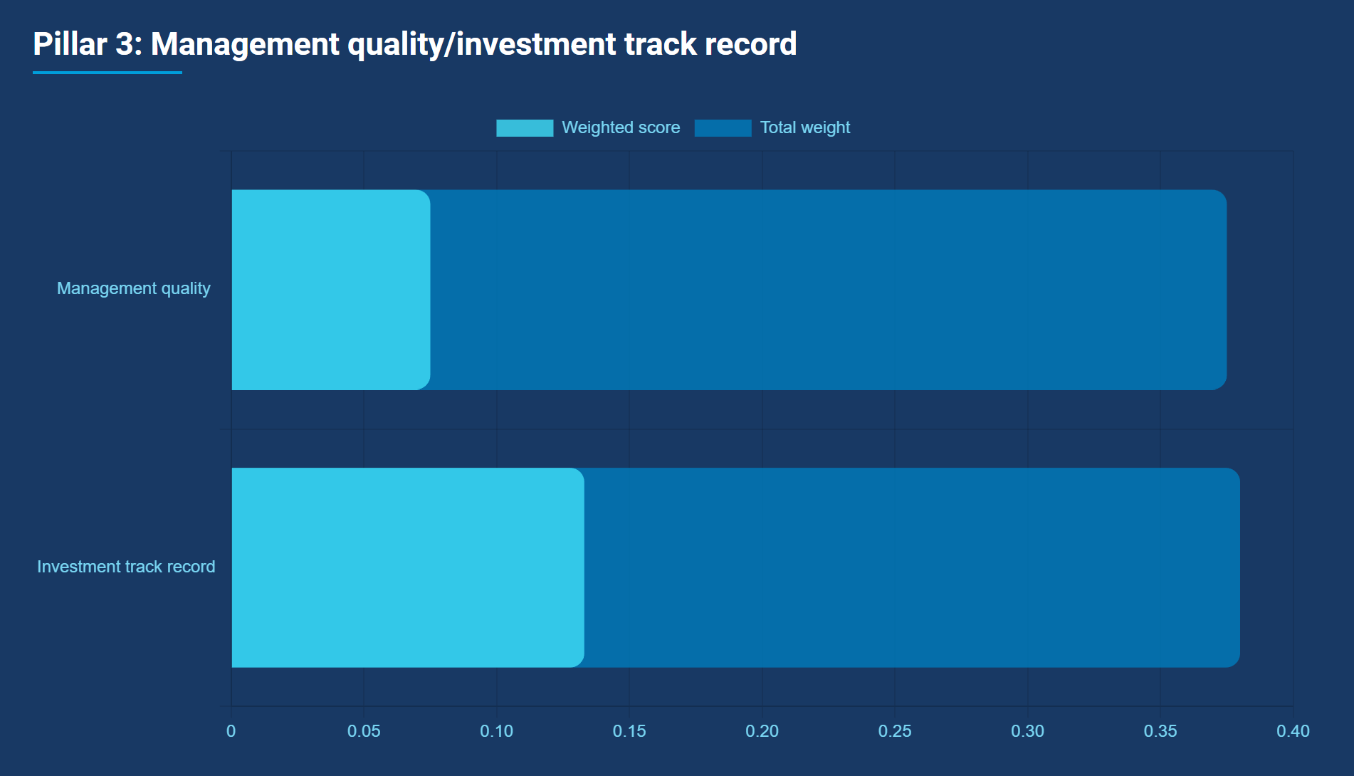
Walkthrough With STAIRS
FINAL SCORE & GAP ANALYSIS

Slide 14
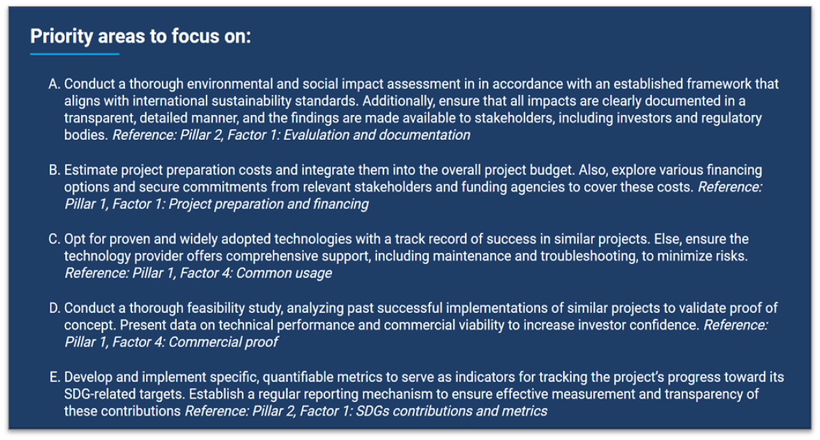
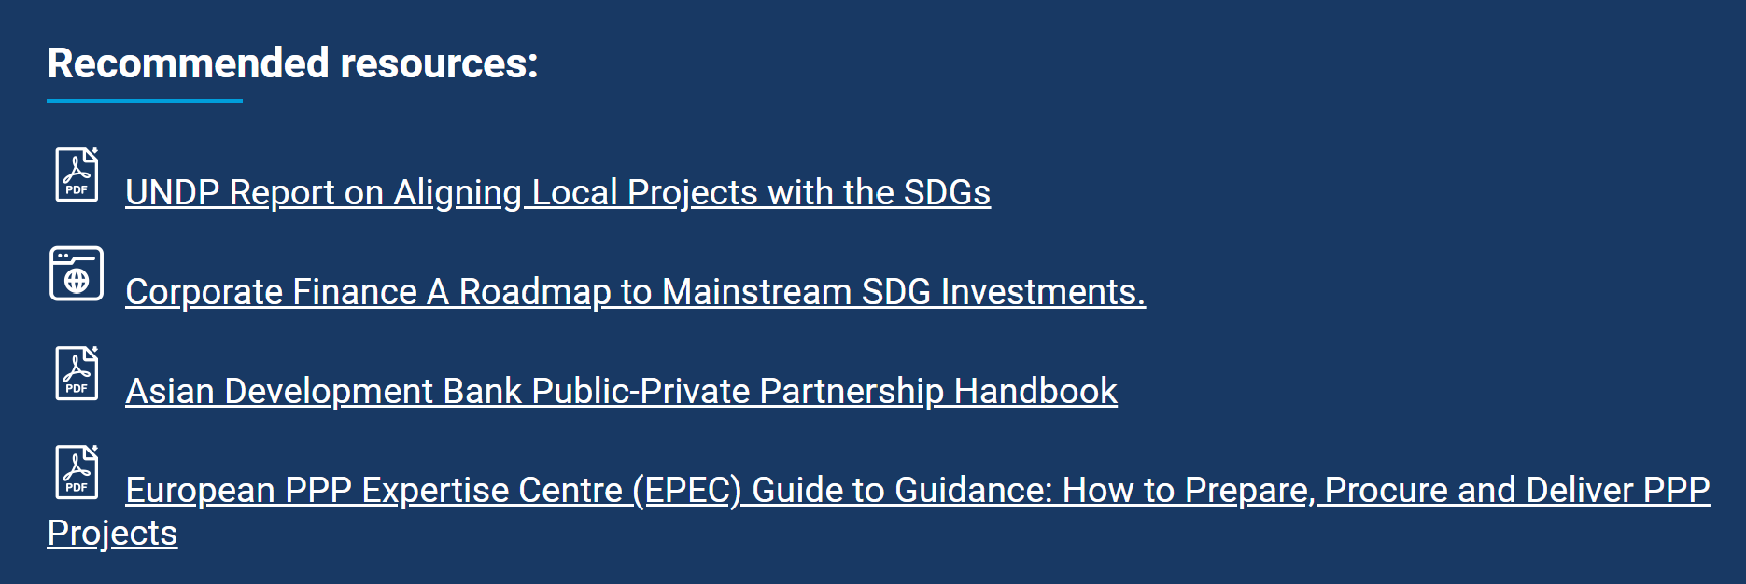
Walkthrough with STAIRS
ACTIONABLE RECOMMENDATIONS & RESOURCE GUIDANCE
Copyright © DESA 2024. All Rights Reserved.

Slide 15
Thank You

