Slide 1



INC Tax
Workstream I: The Framework Convention
First Session – INC Tax
4 - 8 August 2025
Notes:
1

Slide 2
INC Tax Workstream I – Purpose of the Framework Convention
The Framework Convention aims to establish inclusive and effective international tax cooperation, a responsive governance system for ongoing and future tax challenges, and an inclusive, fair, transparent, efficient, equitable, and effective international tax system that supports sustainable development and strengthens domestic resource mobilization.
  Establish fully inclusive and effective international tax cooperation in terms of substance and process;
  Establish a system of governance for international tax cooperation capable of responding to existing and future tax and tax-related challenges on an ongoing basis;
  Establish an inclusive, fair, transparent, efficient, equitable and effective international tax system for sustainable development, with a view to enhancing the legitimacy, certainty, resilience and fairness of international tax rules, while addressing challenges to strengthening domestic resource mobilization.

Slide 3
INC Tax Workstream I – Why prioritize commitments?
The work plan prioritizes drafting the commitments by the end of 2025, as they are technical tax provisions that would anchor both early and future protocols to the Framework Convention.
The workstream selected commitments on effective prevention and resolution of tax disputes, fair allocation of taxing rights, and sustainable development to present during this session.
The issues note serves as the starting point for the discussions during this session. The main goal of this Session is to gather further feedback that will inform subsequent intersessional work.

Slide 4
INC Tax Workstream I – Order in which issues will be taken up
Provisions whose drafting depends at least in part on drafting of commitments
Provisions that are not subject-matter dependent that can be drafted at any time
Provisions to be addressed early
Commitments:
Fair allocation of taxing rights
Effective prevention and resolution of tax disputes
Sustainable development
High net worth individuals
Effective mutual administrative assistance
Illicit financial flows, tax avoidance and tax evasion
Harmful tax practices
Conference of the parties
Secretariat
Definitions
Data collection and analysis
Exchange of information for implementation of the convention
Review and verification
Subsidiary bodies
Capacity building and technical assistance
Amendments to the convention
Adoption of protocols
Formal matters – depositary, entry into force, etc.
Financial resources

Slide 5
Effective prevention and resolution of tax disputes
Notes:
5

Slide 6
INC Tax Workstream I – Why prioritize prevention and resolution of tax disputes
Tax litigation is costly and time-consuming. Fair and effective alternative mechanisms enhance legal certainty, reduce burdens, and support efficient tax administration and revenue mobilization.
Cross-border tax disputes are complex and slow to resolve, leaving double taxation risks.
Developing countries face added challenges due to limited treaty networks, highlighting the need for stronger dispute prevention mechanisms.
Asymmetry of information between the taxpayer and tax authorities continues to be an issue, especially for developing countries.

Slide 7
INC Tax Workstream I – Relationship between the Framework Convention and Protocol 2 on prevention and resolution of tax disputes
Protocol
Dispute settlement provision
Provisions on dispute settlement and the commitment on effective prevention and resolution of tax disputes in the Framework Convention need to be aligned with the provisions in the Protocol to interact with each other while maintaining separate scopes.
Commitment

Slide 8
INC Tax Workstream I – Effective prevention and resolution of tax disputes
Possible elements of the commitment:
A statement recognizing the importance of legal certainty to cross-border trade and investment, with the ultimate goal of improving domestic resource mobilization.
An undertaking to establish dispute prevention and resolution mechanisms that are fair, independent, accessible, and effective in resolving disputes in a timely manner for both taxpayers and the tax authorities involved.

Slide 9
INC Tax Workstream I – Effective prevention and resolution of tax disputes
The Committee is invited to discuss the issue of effective prevention and resolution of tax disputes and, in particular, whether:
the elements of the commitments from the previous slide effectively would address the concerns that have been expressed in the workstream with respect to effective prevention and resolution of tax disputes;
the elements of the commitments from the previous slide would provide sufficient support for the early protocol being developed in Workstream III; and
there are additional concerns regarding effective prevention and resolution of tax disputes that should be addressed in that article of the Framework Convention.

Slide 10
Fair allocation of taxing rights
Notes:
10

Slide 11
INC Tax Workstream I – Relationship between the Framework Convention and Protocol 1 on taxation of income derived from the provision of services in an increasingly digitalized and globalized world
Commitment
Protocol on services
A commitment on fair allocation of taxing rights, including equitable taxation of multinational enterprises, could provide an anchor in the Framework Convention for Protocol 1

Slide 12
INC Tax Workstream I – Fair allocation of taxing rights
Aspects of fairness important to Member States:
Important for supporting DRM and restoring taxing rights eroded by evolving business models.
Should ensure that all jurisdictions where business activity occurs share taxing rights (questions remain about the economic basis for allocating such rights).
The proposed criteria should emphasize economic substance and value creation, while considering impacts on trade, investment, efficiency, neutrality, and simplicity.
Rules should be future-proof, adaptable to evolving business models.
While fairness is subjective, its elements may emerge as the Framework Convention and its protocols address aspects of the current system.

Slide 13

INC Tax Workstream I – Fair allocation of taxing rights
The commitment should urge parties to:
Promote an approach where all jurisdictions where business activity takes place share taxing rights over related income.
Balance it with principles of economic efficiency, tax neutrality, simplicity, and effects on cross-border trade and investment.

Slide 14
INC Tax Workstream I – Fair allocation of taxing rights
The Committee is invited to discuss the issue of fair allocation of taxing rights and, in particular, whether:
the elements of the commitment from the previous slide provide a useful outline of a commitment on this topic; and
there are additional concerns regarding the fair allocation of taxing rights that should be addressed in that article of the Framework Convention.

Slide 15
Sustainable development
Notes:
15

Slide 16
INC Tax Workstream I – Sustainable development
This commitment aims to ensure international tax cooperation is aligned with the achievement of sustainable development in its three dimensions: economic, social, and environmental.
Language draws from the Terms of Reference, reflecting widely understood UN principles and can largely reproduce subparagraph (c) of Paragraph 10 of the ToR:
Taking into account their different capacities, the States Parties agree to pursue international tax cooperation approaches that will contribute to the achievement of sustainable development in its three dimensions, economic, social and environmental, in a balanced and integrated manner.
A commitment in this form would primarily serve as an anchor for future protocols.

Slide 17
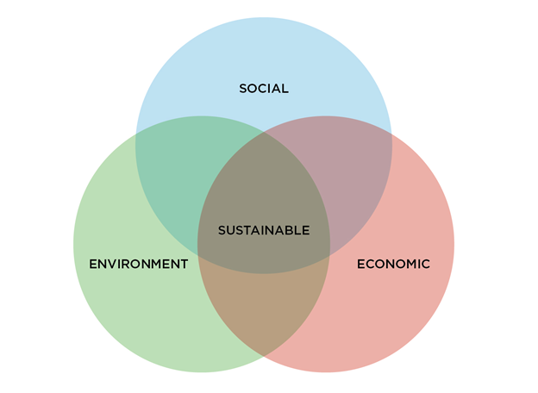
INC Tax Workstream I – Sustainable development
The Committee is invited to discuss the issue of international tax cooperation approaches that contribute to sustainable development and, in particular, whether there are additional aspects of international tax cooperation approaches that contribute to sustainable development that should be addressed in additional paragraphs of that article of the Framework Convention.

Slide 18
Next steps
Notes:
18

Slide 19
INC Tax Workstream I – Next Steps
With respect to remaining subjects for commitments from paragraph 10 of the ToR, issues regarding developing countries’ access to information are common to several of these subjects. They will be presented as a comprehensive package at the Committee’s November 2025 Session to ensure common or complementary approaches.
Commitments on additional subjects may be considered, subject to the Committee completing its tasks on schedule.

Slide 20
Discussion or questions
Notes:
20

Slide 21
Thank you!
Notes:
21

