Slide 1



INC Tax
Workstream II: Taxation of Income derived from the provision of services in a digitalized and globalized economy
Second Session – INC Tax
11 August 2025
Notes:
1

Slide 2
INC Tax Workstream II – Overview
During the meetings, the workstream heard that the most significant barriers to taxing cross-border services consisted of legal barriers in tax treaties that do not reflect current ways of doing business.
Many developing countries impose gross basis withholding taxes on almost all payments made from their jurisdictions, which allows them to tax without regard to where services are provided.
Treaty rules that allow taxation only when the service provider has a physical presence in a country do not align well with these domestic systems.

Slide 3
INC Tax Workstream II – Overview (cont.)
Advances in digital technology make it easier than ever to provide services remotely, although some services do, of course, still require physical presence.
Recently, the focus has been on the treatment of digital services, but concerns regarding fees for management, technical and consultancy services go back decades.
The workstream therefore considered a number of situations (among them those in the following slides) to ask, if there were no existing international tax rules, should the state where services are consumed have the right to tax the payment and what would be the justification for doing so.

Slide 4
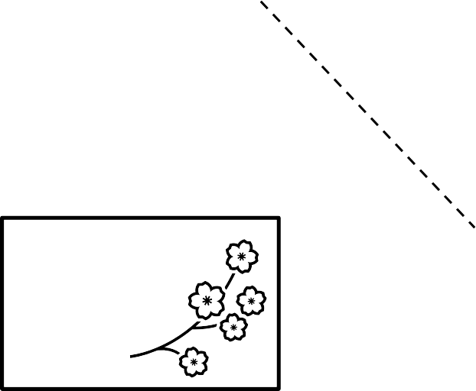
INC Tax Workstream II – Example on Intracompany services
State R
BigCo
Fees for specialist services
BigCo employees in State P for fewer than 183 days/year
State P
SubCo
The question is how to share taxing rights between State P and State R.

Slide 5
INC Tax Workstream II – Example on legal services
State R
Sole Proprietorship
Legal services
Client Co
State P
The question is how to share taxing rights between State P and State R.

Slide 6
INC Tax Workstream II – Example on remote legal services
State R
Sole Proprietorship
Legal services
Client Co
State P
The question is how to share taxing rights between State P and State R.

Slide 7
INC Tax Workstream II – Example on digital services
State R
Social MediaCo
Advertising buy
Content plus
Advertising
BigCo
State P
User
The question is how to share taxing rights between State P and State R.

Slide 8
INC Tax Workstream II – Discussion of possible new approaches
The primary goal of any new rules should be to support domestic resource mobilization by providing for a fair allocation of tax revenues.
Other goals are to:
  Eliminate barriers to cross-border trade and investment;
  Be aligned with economic efficiency and ensure tax neutrality;
  Achieve simplicity and administrability.
Any new nexus rules must be “future-proof” by satisfying these criteria even as business models change in ways that are impossible to now foretell.

Slide 9
INC Tax Workstream II – Discussion of possible new approaches (cont.)
Possible new nexus rules?
Continued role of physical presence?
Net and gross basis taxation?
Possibility of different rules for different types of services?
Taxes covered

Slide 10
INC Tax Workstream II – Questions for the INC Plenary
The Issues Note concludes by inviting the Committee to consider the following questions:
(a) Whether the Issues Note comprehensively describes current rules for the taxation of services and the reasons behind the call for change, or whether there are additional considerations that should be taken into account in the workstream’s deliberations;
(b) what considerations are most important in developing possible new rules for the taxation of services; and
(c) how the workstream can best define the scope of the protocol in terms of the taxes and services that it will cover.

Slide 11
Thank you!
Notes:
11

